Slide 1
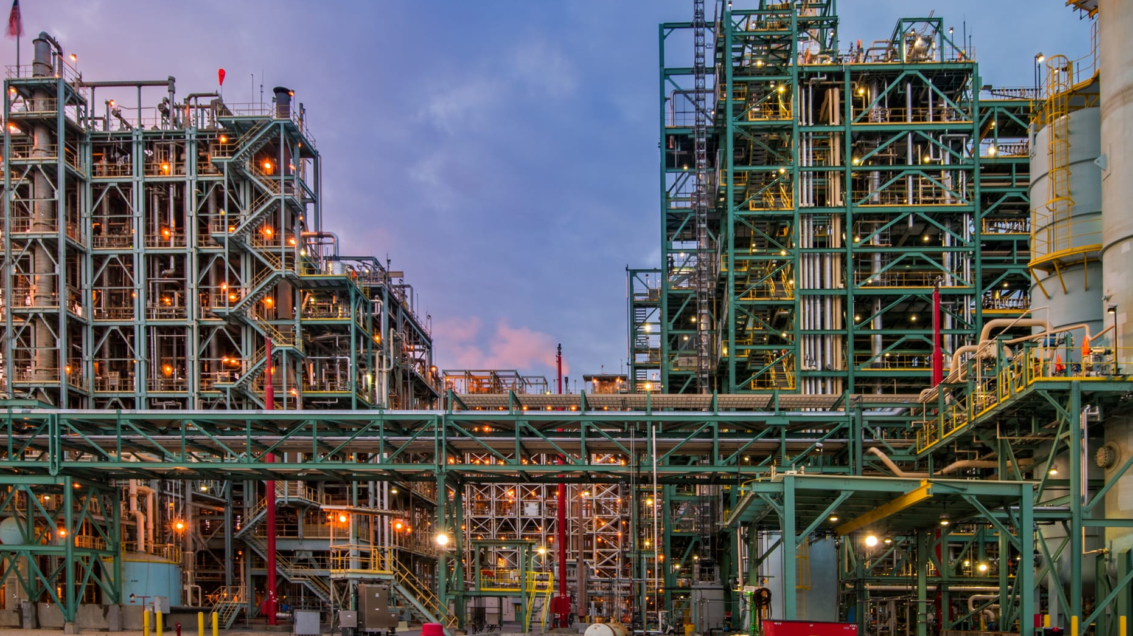
Deep Learning for Time Series in Industry
Part III: Beyond forecasting
Notes:
https://app.aiplus.training/courses/deep-learning-for-time-series-in-indusrtry-the-promise-and-the-barriers

Slide 2
Flow Forecast
Notes:
https://github.com/AIStream-Peelout/flow-forecast

Slide 3
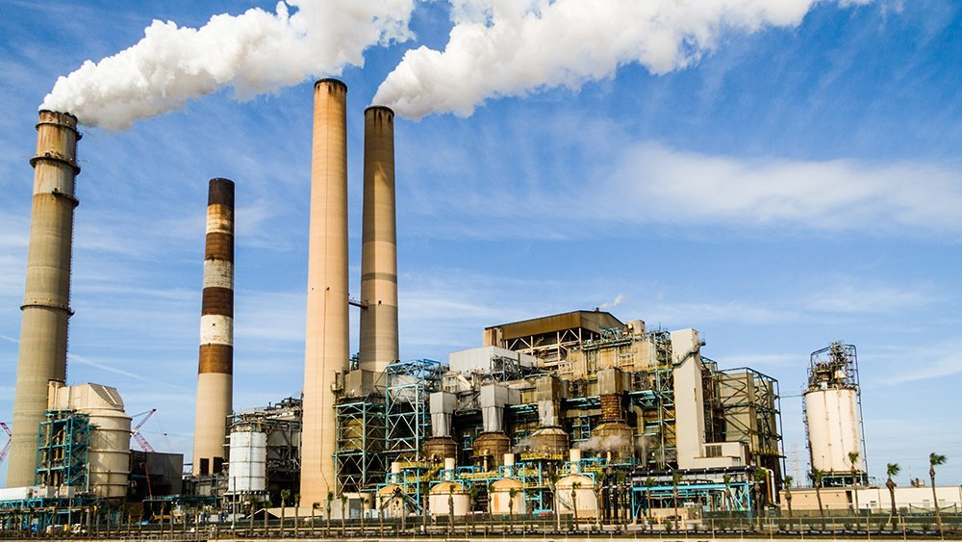
Frequent things I’ve heard about deep learning methods
It is a black box stakeholders will never be able to understand what is going on…” - Interpretability
“Isn’t deep learning only good when we have really large datasets? Our data is too small for the model to learn anything”
“Deep learning is too hard to deploy and the code complexity isn’t worth the added overhead”
“The performance improvements are marginal and not worth having to deal with the above complicating factors”

Slide 4
Performance Improvements are significant
“The empirical studies conducted and reported in this article show that deep learning-based algorithms such as LSTM outperform traditional-based algorithms such as ARIMA model. More specifically, the average reduction in error rates obtained by LSTM was between 84 - 87 percent when compared to ARIMA indicating the superiority of LSTM to ARIMA.” – https://par.nsf.gov/servlets/purl/10186768
”methods to predict short-term traffic flow, and experiments demonstrate that Recurrent Neural Network (RNN) based deep learning methods such as LSTM and GRU perform better than auto regressive integrated moving average (ARIMA) model.” - https://ieeexplore.ieee.org/abstract/document/7804912

Slide 5
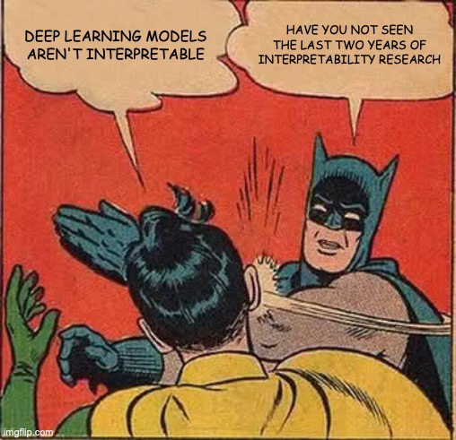

Slide 6
Brief overview of DL interpretability methods
SHAP
Saliency maps
Visualizing the attention mechanism weights
Basic perturbations
Gradient based methods
Brief overview of DL interpretability methods
Brief overview of DL interpretability methods

Slide 7
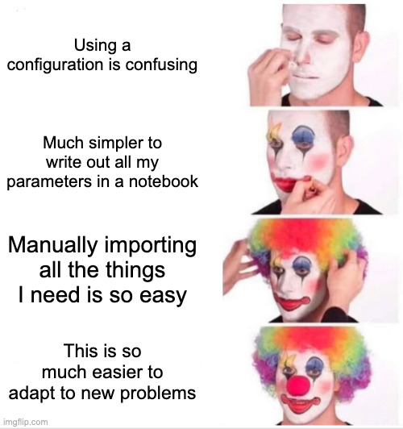
Experiment Tracking and Deployment
Configuration files are useful for tracking parameters and reproducing results
Easier in the long run to use than spaghetti code written in Python.
Simplifies running many experiments with different hyper-parameters
Allows you to easily reproduce results
Notes:
https://github.com/AIStream-Peelout/flow_tutorials/blob/main/traffic/Forecasting_Tutorial.ipynb

Slide 8
Deep Learning Time Series Research History
2015–2018
Vanilla LSTMs/GRUs
2017–2020
LSTMs/GRUs + Vanilla Attention
DA-RNN
Temporal Pattern Attention
DSA-Net
2019-present
Self-Attention variants
Conv Transformer
TFT

Slide 9
Today’s talk
Using Flow Forecast for time series classification anomaly detection, multi-task learning and time series embedding analysis.
Real World Examples
River Flow Forecasting and Flash Flood Anomaly Detection
Avocado Price Forecasting/Classification
COVID-19 Pandemic Forecasting and Analysis
Flow Forecast under the hood and roadmap
Construction of FF and software engineering uniqueness
Features in progress (all the features I’d like to add but don’t have the time too and why you should contribute)
Your questions/feedback…

Slide 10
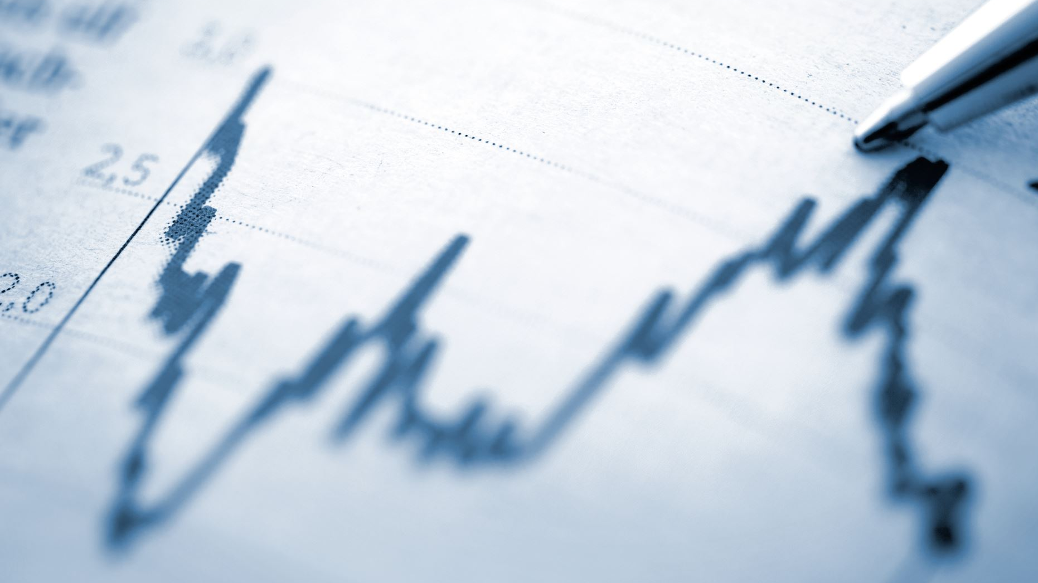
Clarifying terminology
Time Series Forecasting: trying to predict the value of some target variable at time t+1, t+2, etc…
Time Series classification: trying to assign a label to a sequence of time steps
Time Series Anomaly detection: Trying to assign a binary label (0, 1) to a sequence of time steps where there is a disproportionate amount of one class by a large margin.
There can be a lot of overlap and interplay between these as we will see!

Slide 11
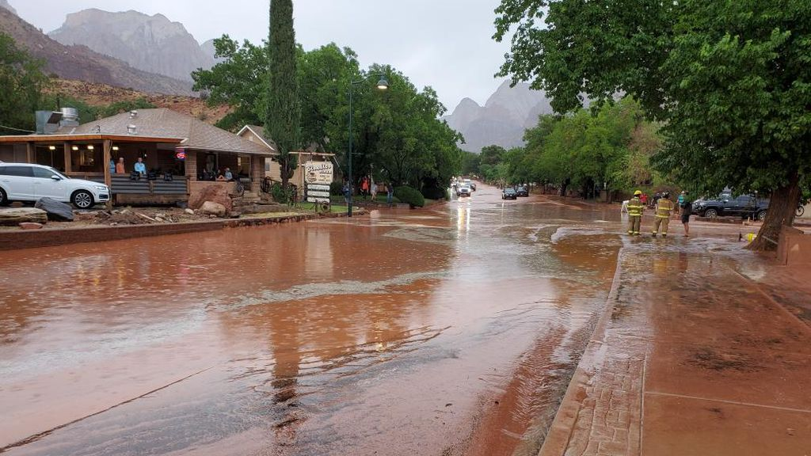
River Flow and Flash Flood Prediction
Flash floods are one of the worst natural disasters in terms of loss of life and property damage
Better prediction of events can provide timely alerts to people particularly in outdoor recreation areas (canyons, dry washes, etc)

Slide 12
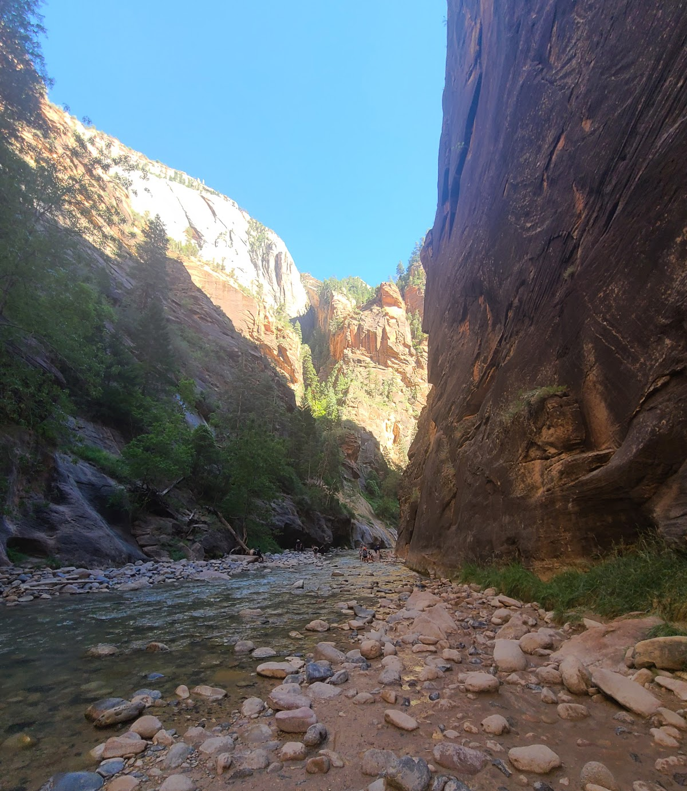
Virgin River Forecasting Zion
Commonly hiked river in Zion N.P
Severe flash floods
Flow somewhat correlates
Notes:
https://youtu.be/W3akkSEGFhI?t=86
https://wandb.ai/igodfried/github_aistream-peelout_flow-forecast/reports/Virgin-River-Flow-Forecasting-and-Analysis--VmlldzozODY5NTQ

Slide 13
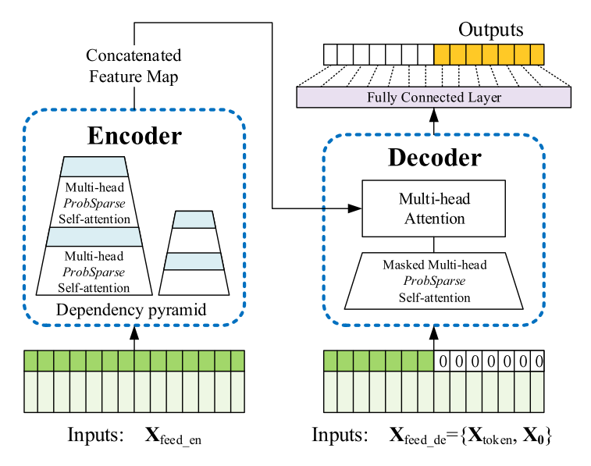
The Informer
New state of the art model released at AAAI 2020
Won best paper at AAAI (so it must be good)!
But could it solve the problem of forecasting the Virgin River in Zion?
Notes:
https://wandb.ai/igodfried/flow-forecast/runs/txupxvv3?workspace=user-igodfried

Slide 14
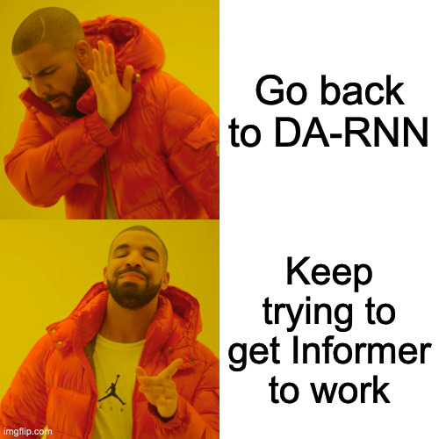
Notes:
https://wandb.ai/igodfried/flow-forecast/runs/txupxvv3?workspace=user-igodfried

Slide 15
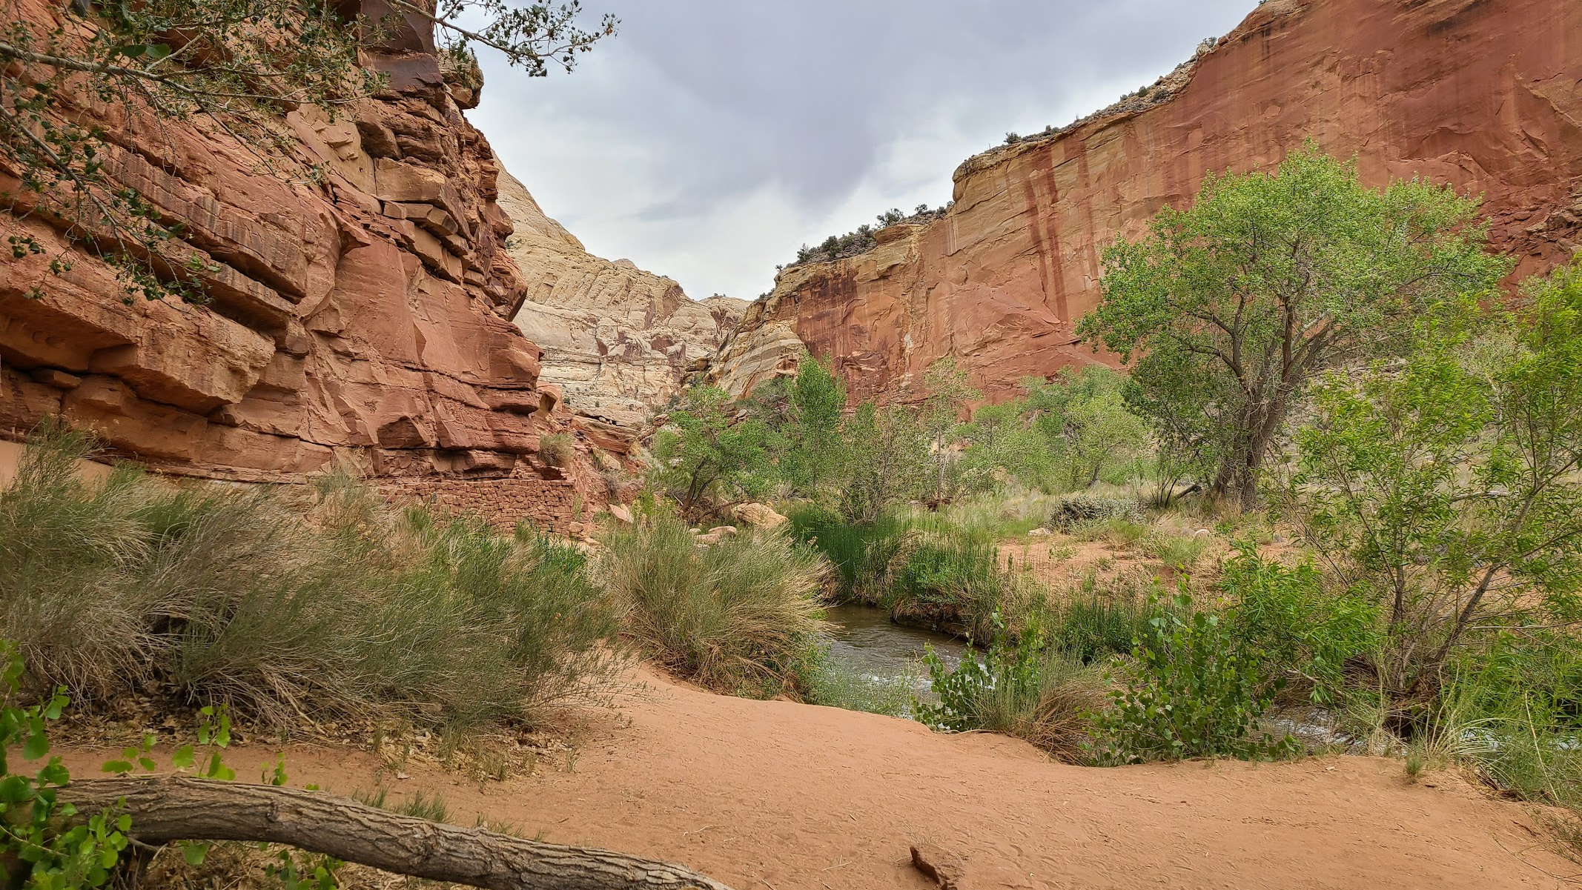
Redefining Goals and Priorities
Exact river flow/precipitation likely isn’t that valuable
Instead, prediction of extreme precipitation events and location of the rainfall is more important

Slide 16
Multi-Station Anomaly Detection and TS Forecasting

Slide 17
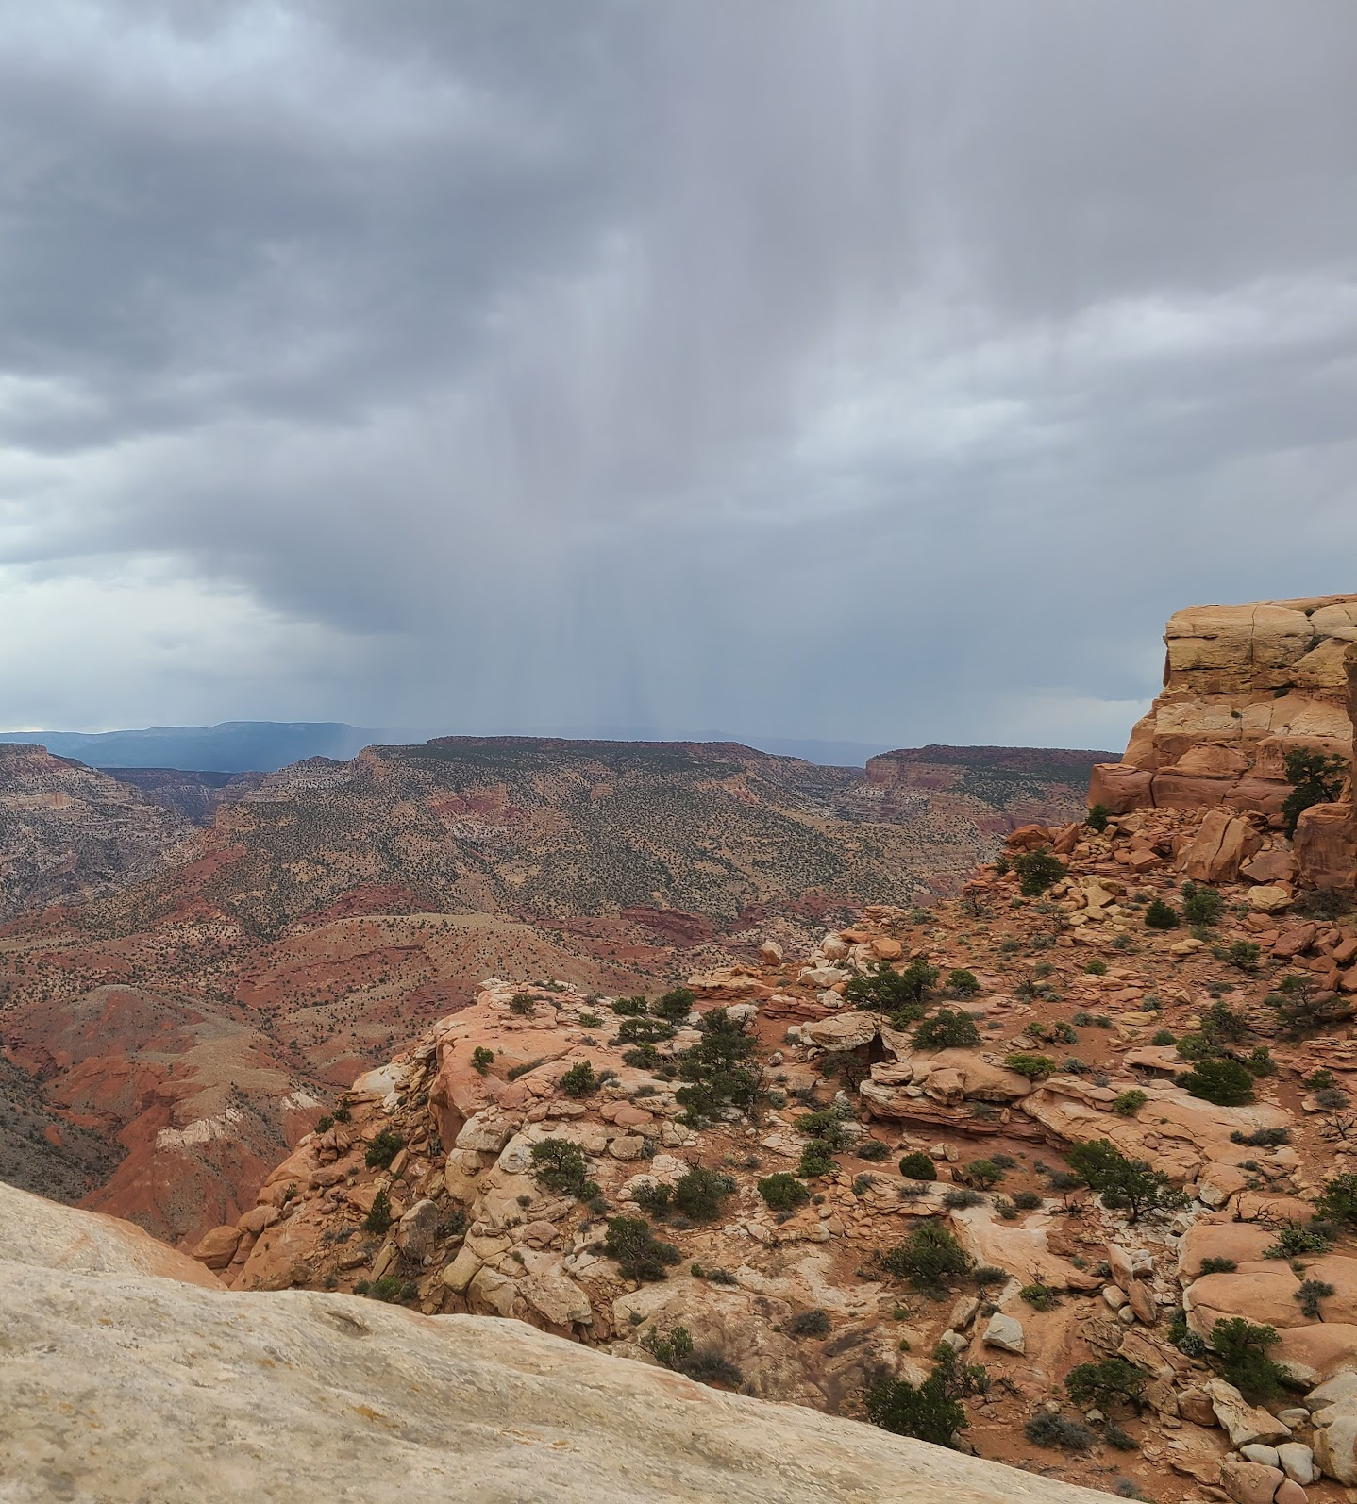
Climate state representation learning
Notes:
https://colab.research.google.com/drive/15XSKiSmJyrwhL685TvRqQ2LkYAvAR9Li#scrollTo=WP_GQ1UuLCTz

Slide 18
COVID-19 Cases, deaths, and vaccinations
Core Goals:
Accurately forecast the number of new cases, hospital admissions, and deaths at the county level
Tell epidemiologists about relevant predictive features regarding COVID-19
Allow model users to simulate different scenarios and compare impacts of policies on COVID

Slide 19
Multi-task forecasting cases + deaths
Notes:
https://wandb.ai/igodfried/covid_icml/runs/018wc0fa?workspace=user-igodfried

Slide 20
Classifying Cases
Classify COVID cases based on standardized severity scores
Notes:
https://colab.research.google.com/drive/1iZJNP7m4MmL-wa5yrSQPXZm-W0mH2IlO#scrollTo=I_kA01n0WgVi

Slide 21
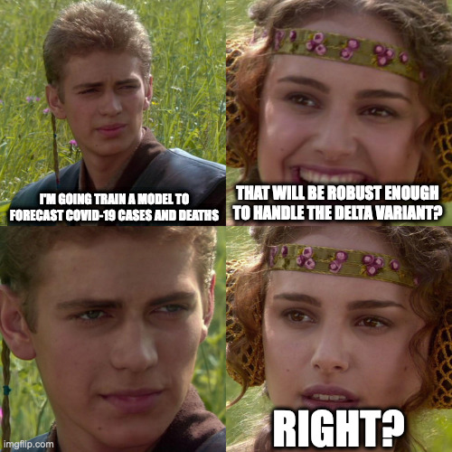

Slide 22
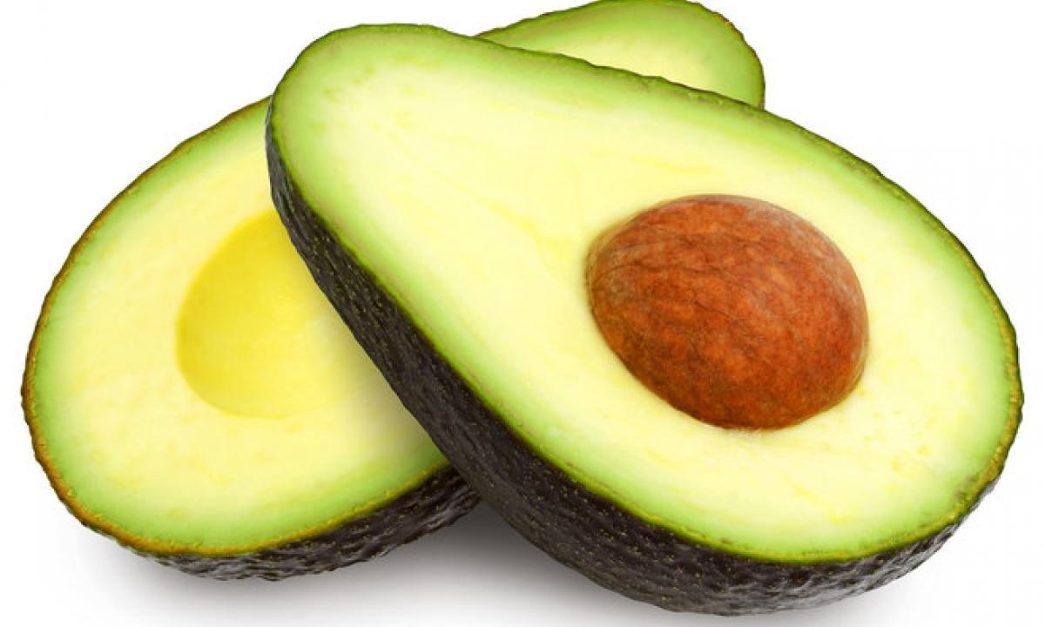
Avocado Price Forecasting
Notes:
https://www.kaggle.com/isaacmg/avocado-price-forecasting-with-flow-forecast-ff/
https://wandb.ai/igodfried/avocado_flow_forecast/runs/38dh7gqr?workspace=user-igodfried

Slide 23
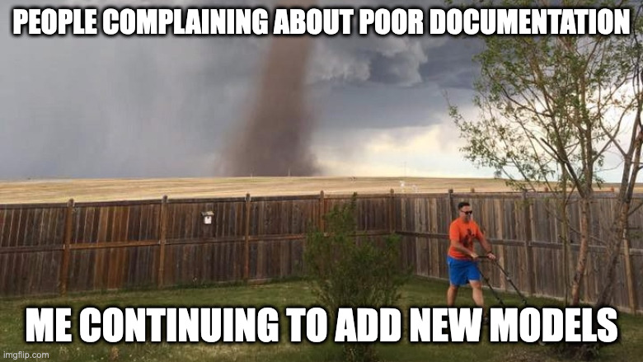
Improving Flow Forecast

Slide 24
Handling of multiple time series/series id embedding

Slide 25
Advanced large scale geo-spatial forecasting

Slide 26
Swappable embedding layers/data-loaders

Slide 27
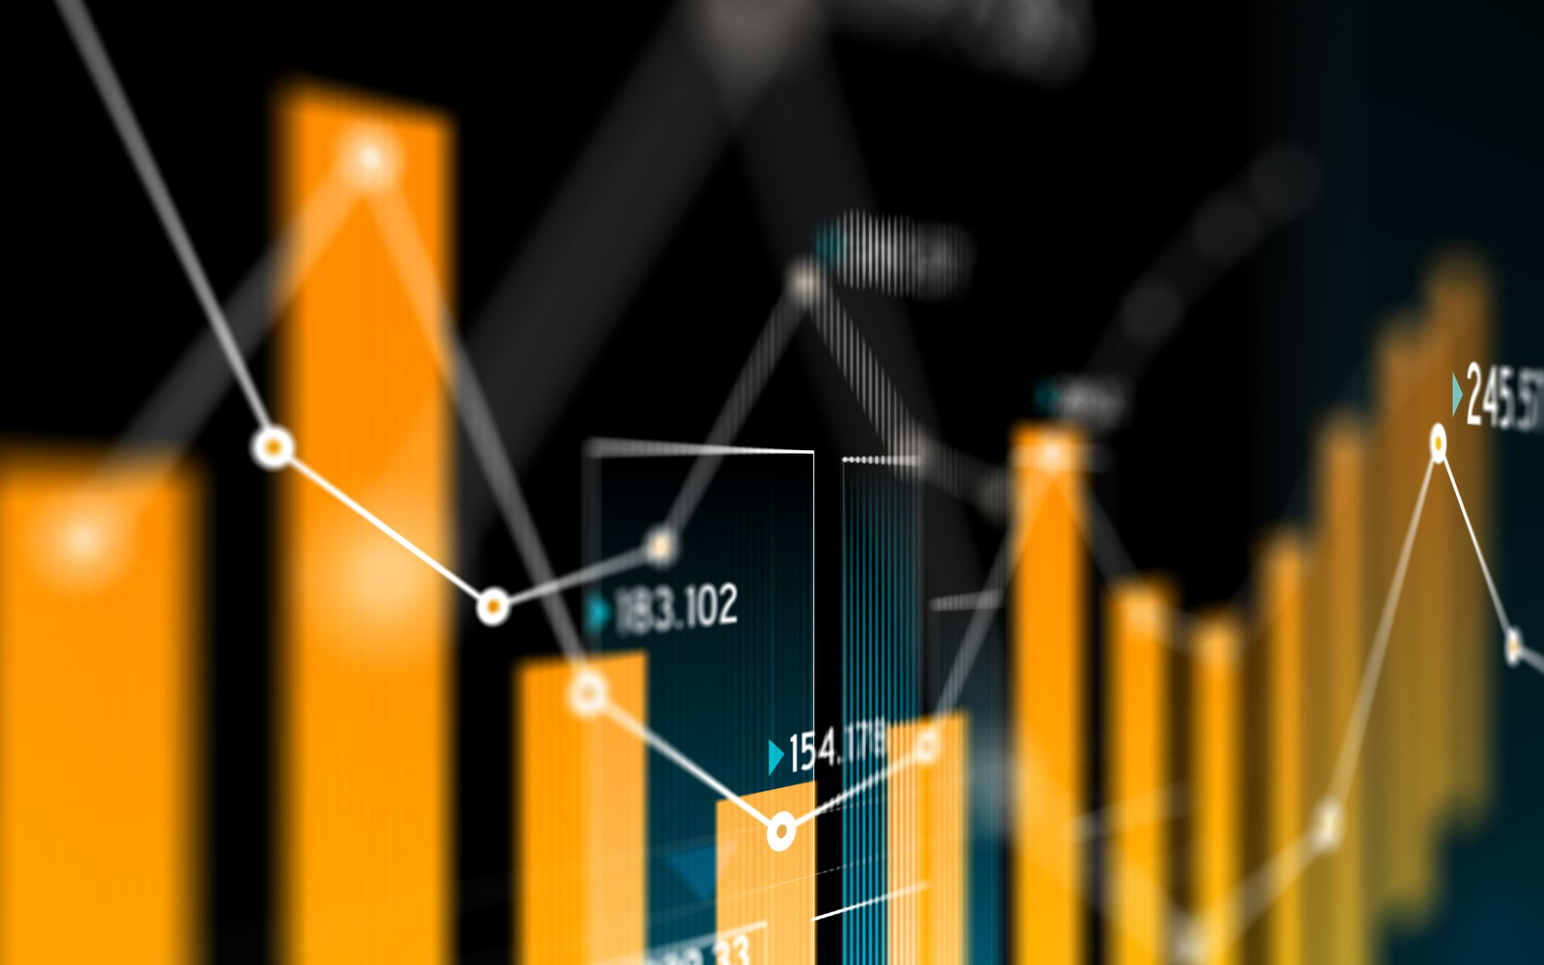
Adding new examples and benchmark data

Slide 28
If you liked what you saw today remember to star Flow Forecast
https://github.com/AIStream-Peelout/flow-forecast

Slide 29
Questions?

