Slide 1
Intel INT8 Solution for MXNet
Intel/SSG/MLT

Slide 2
Content
Plan and Targets
Operator Status
Model Level Optimization
Differentiation (MKL-DNN)
Backup

Slide 3
Plan and Targets
MKLDNN Integration Plan
We prefer to merge our solution with #9552 together so the CPU/GPU INT8 code can share the common code infrastructure and be tested together.
The dependency and tasks:
PR#9677 to be merged (including our FP32 OPs)
PR#9552 rebase on PR #9677 (reminisce)
After 1. is merged, this PR need to be rebased so we can use our MKL-DNN OP.
Need lots of your efforts ☹
3. Submit PR for MKLDNN INT8 OP (Intel SH team)
MKLDNN INT8 Target
Accuracy gap <1% from fp32, such as resnet-50, googlenet v3
Performance
In the first stage, we are not focus on performance very much so suppose 1.0-1.3X faster than FP32;
Intel next step (w/ new HW) INT8 performance will be improved a lot (2-3X).

Slide 4
Operator Status
INT8 Operator Status
PR#9552 | CUDNN | MKL-DNN | Integrated to MXNET | Unit tests
quantization | no | yes | Done | Pass
dequantization | no | yes | Done | Pass
requantization | no | yes | WIP | WIP
conv | yes | yes | Done | Pass
max pooling | yes | yes | Done | Pass
avg pooling | yes | yes | Done | Pass
fc | yes | (MKL library) | TODO | /
relu | no | yes | Done | Pass
concat | no | yes | WIP | WIP
fused(conv/relu/elemwise) | no | yes | WIP | WIP
Local code with PR#9552 merge. [LINK]

Slide 5
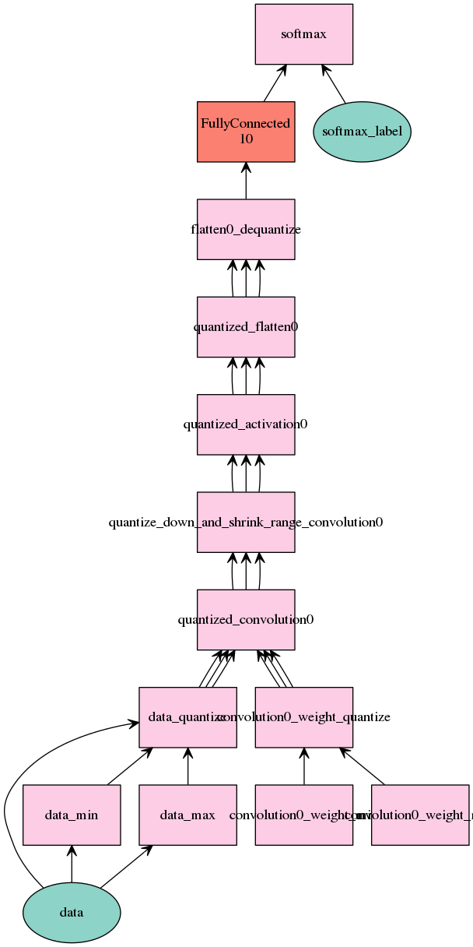
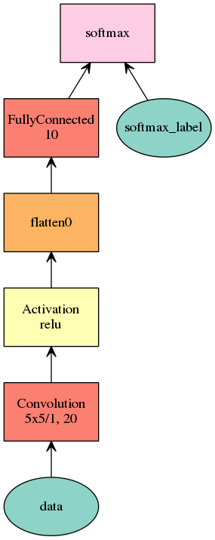
Model Level Optimization
MKL-DNN with ziheng’s quantization branch
In this experiment, conv, relu and flatten layer are used INT8 as left flowchart.
Inference | origin fp32 | after quantization
accuracy | 98.06 % | 97.93 %
FP32 code based on PR#9677
INT8 code refer to [LINK]

Slide 6
MKL-DNN with quantization + calibration PR
In this experiment, conv, we combined MKL-DNN INT8 Ops with the graph optimization and auxiliary OPs in PR#9552.
The similar computation flow as previous page, but the weights quantization is calculated offline.
The accuracy test WIP, you can refer our code in [LINK].

Slide 7
Differentiation (MKL-DNN)
MKLDNN OP
Convolution (for example)
MKLDNN supports any layout, and channel needn’t to be multiple of 4, but more friendly to be multiple of 16. So, we can have full unit tests and less constrain in infer shape to share op registration with CUDNN.
input data type in MKLDNN is u8, so infer type need to support u8 as well.
Requantize
MKLDNN supports s8/u8 output besides s32 output by shrinking range inside API.
can use macro to switch between MKLDNN/CUDNN.

Slide 8
Backup

Slide 9
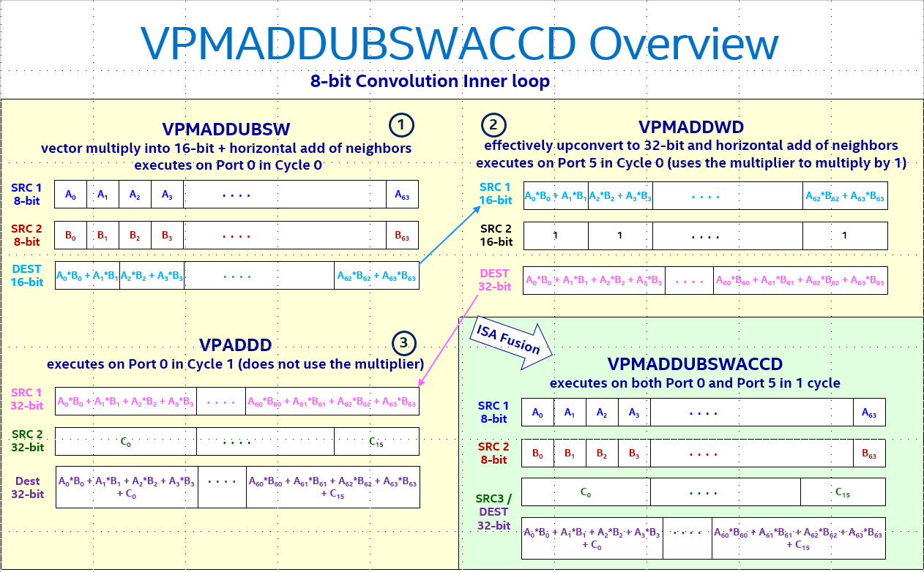
ISA Support of INT8 Multiply-Add

